Slide 1
JAVA Project
TOPIC:- Online Air Ticket Booking System.
Name : Jay Taraviya
Enroll. : 91800151030
Guided by :Proff. Pratiti Mankodi Ma'am

Slide 2
INTRODUCTION.
Airline reservation System is a computerized system.
Enhancing the relationship between customers and airline agencies.
Convenient for the customers to book the flights .
Allow the customers to access database and allow new customers to sign up for online access.

Slide 3
List of used tools which i used in these project :
JSP
Java Servlet
JDBC
MySql

Slide 4
Modules:
Welcome page
Login page to book ticket
Updated database
Admin panel

Slide 5
Description:
Main and Login Page: The main page, neatly designed page, here login option is provided to login. Also new signup option is provided to for new user to signup.
Ticket booking page: This screen displays the required option to book a ticket.
Registration Screen: This page contains the required options to register with the site

Slide 6
Administrator Page: This page is very important as this allows the administrator of this site to manage the different aspects of air ticket reservation related activities like add flights, user data, edit or delete flights etc.
Flights Details Screen: This screen shows the option to create new flights, timings etc. This page can only be accessed by administrator

Slide 7
Booking Confirmation Screen: This is the final screen in buying process. Here customer confirms the book .

Slide 8
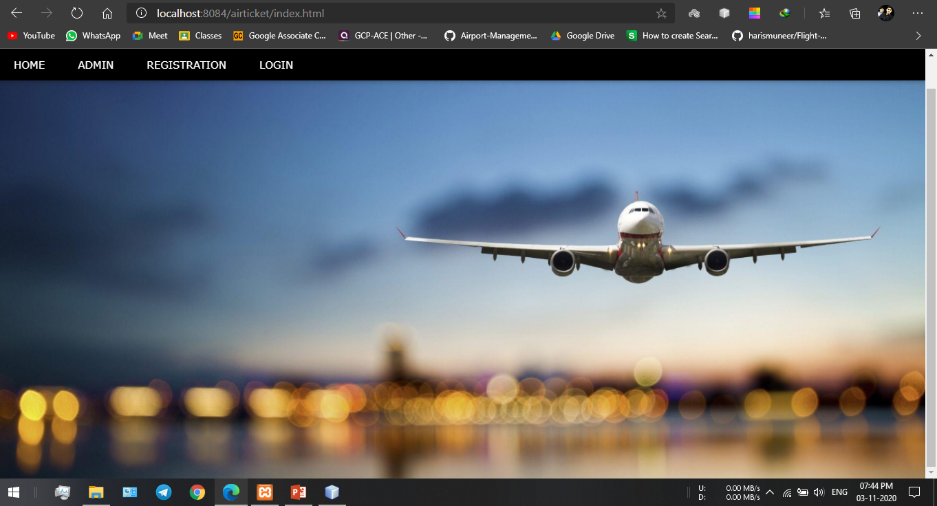
Some Snapshot of main functionalities
Welcome Page.

Slide 9
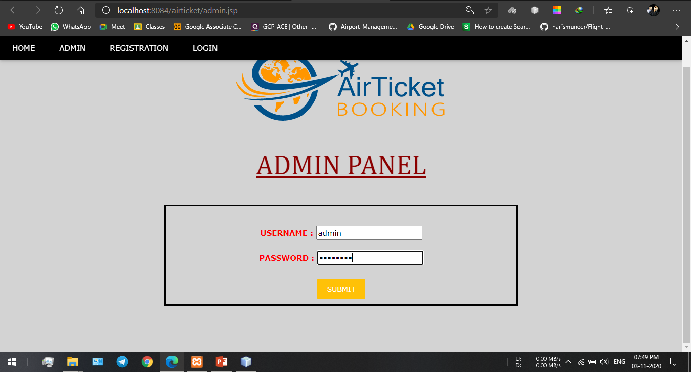
Admin Login

Slide 10
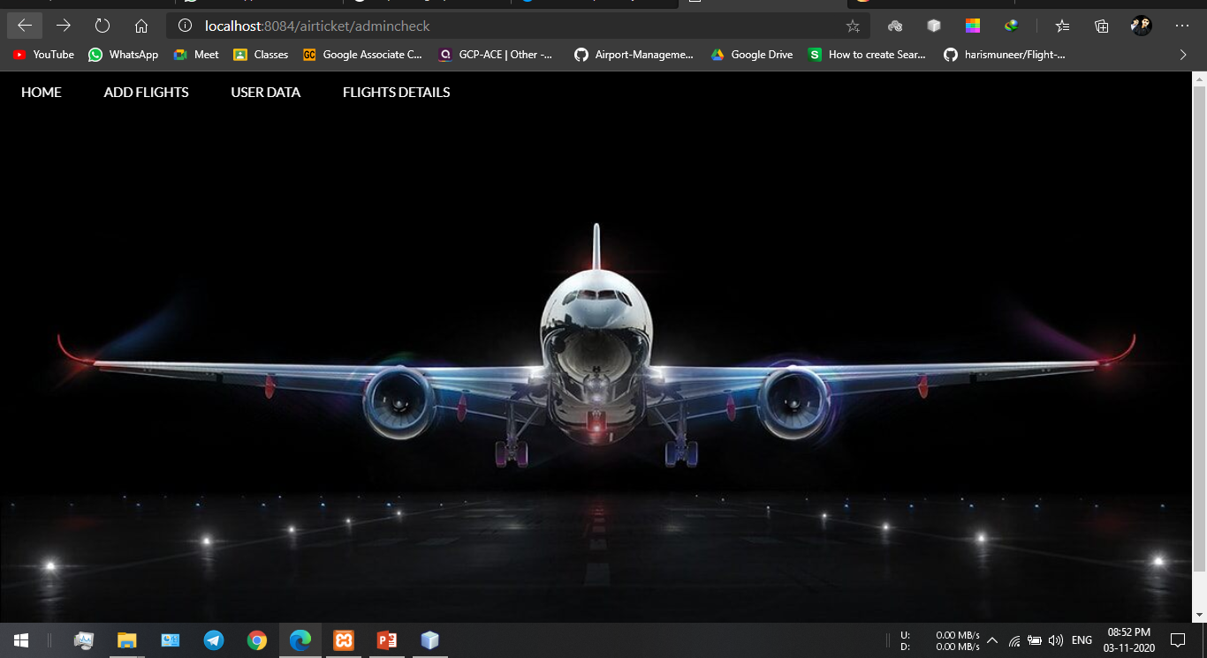
Admin Page.

Slide 11
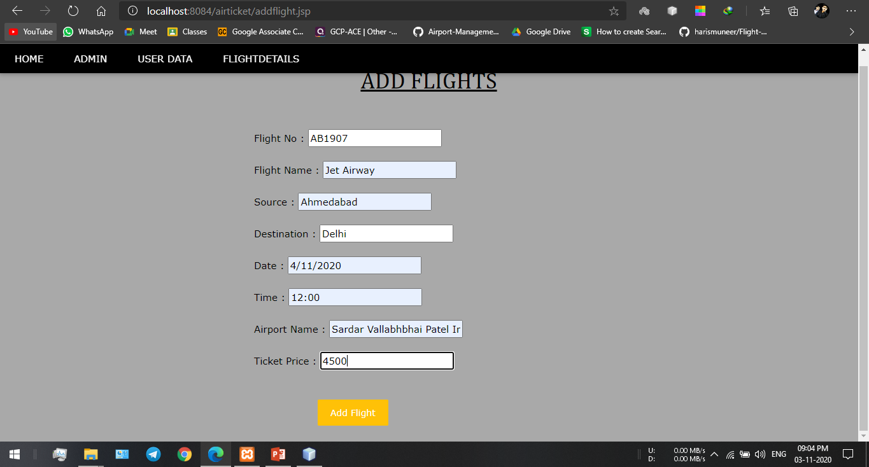
Add Flight.

Slide 12
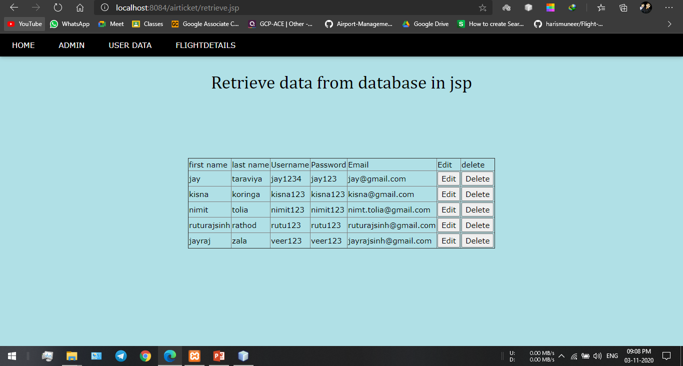
User Data.

Slide 13
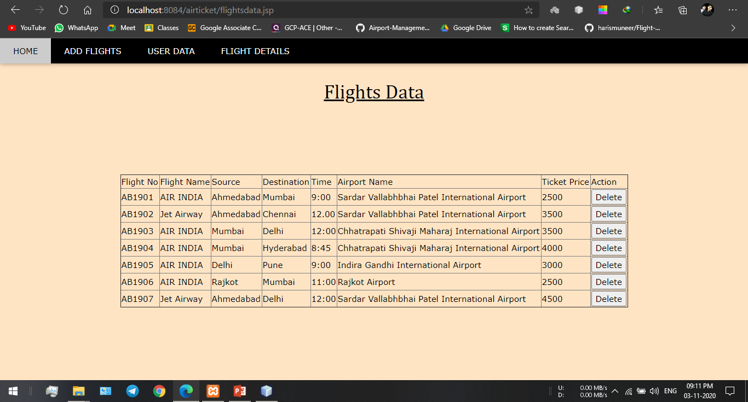
Flights Data.

Slide 14
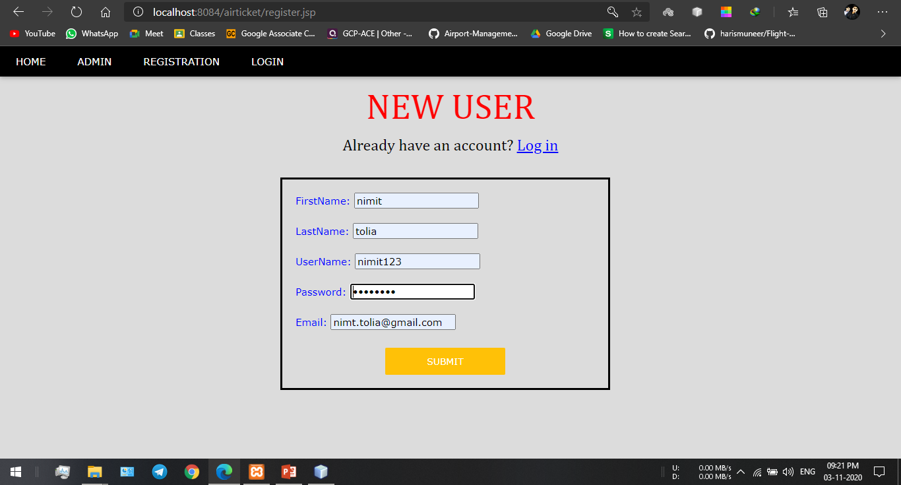
New Registration.

Slide 15
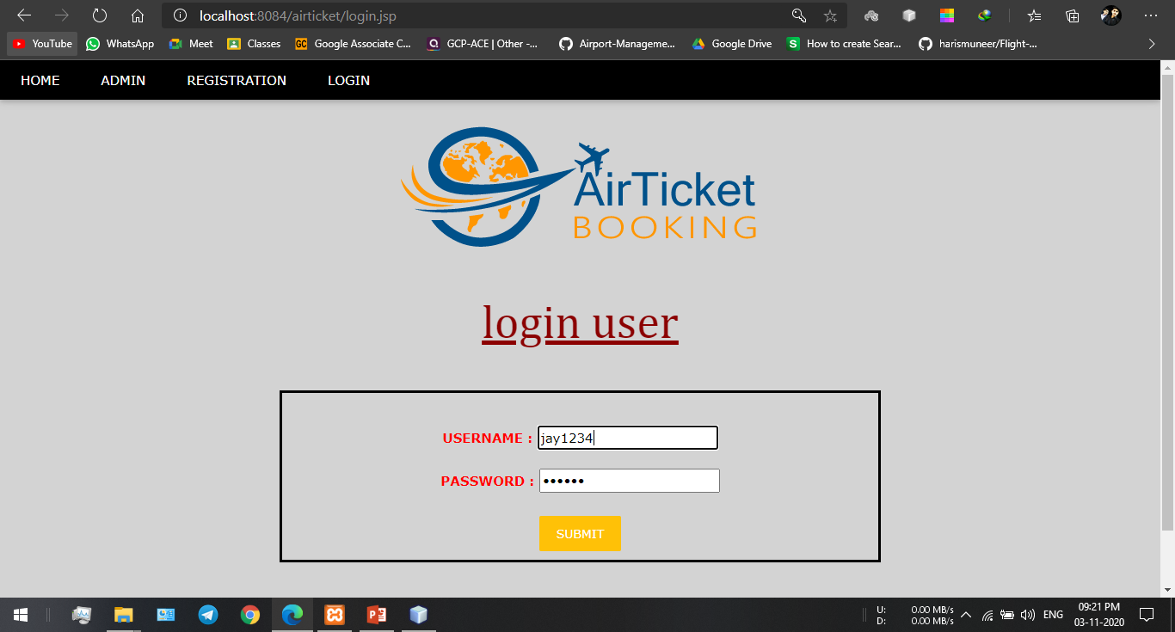
Login.

Slide 16
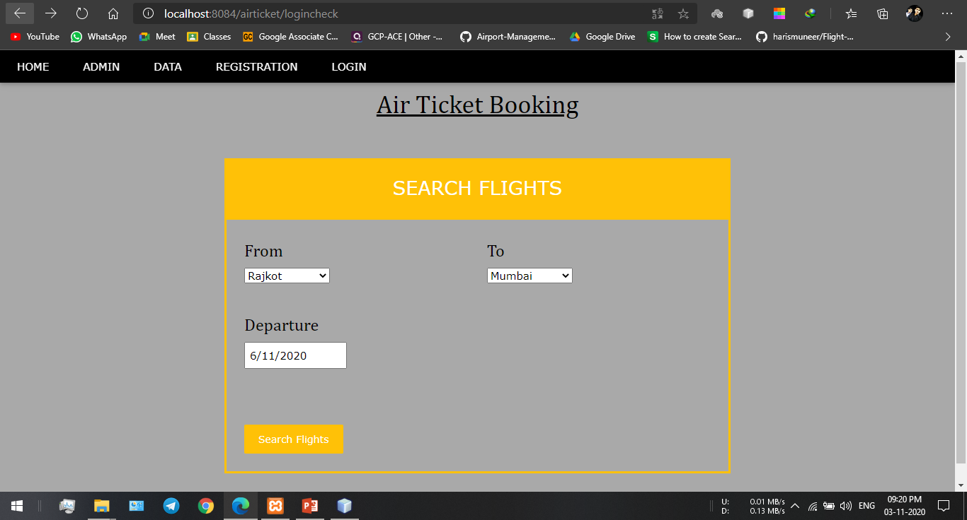
Search flight.

Slide 17
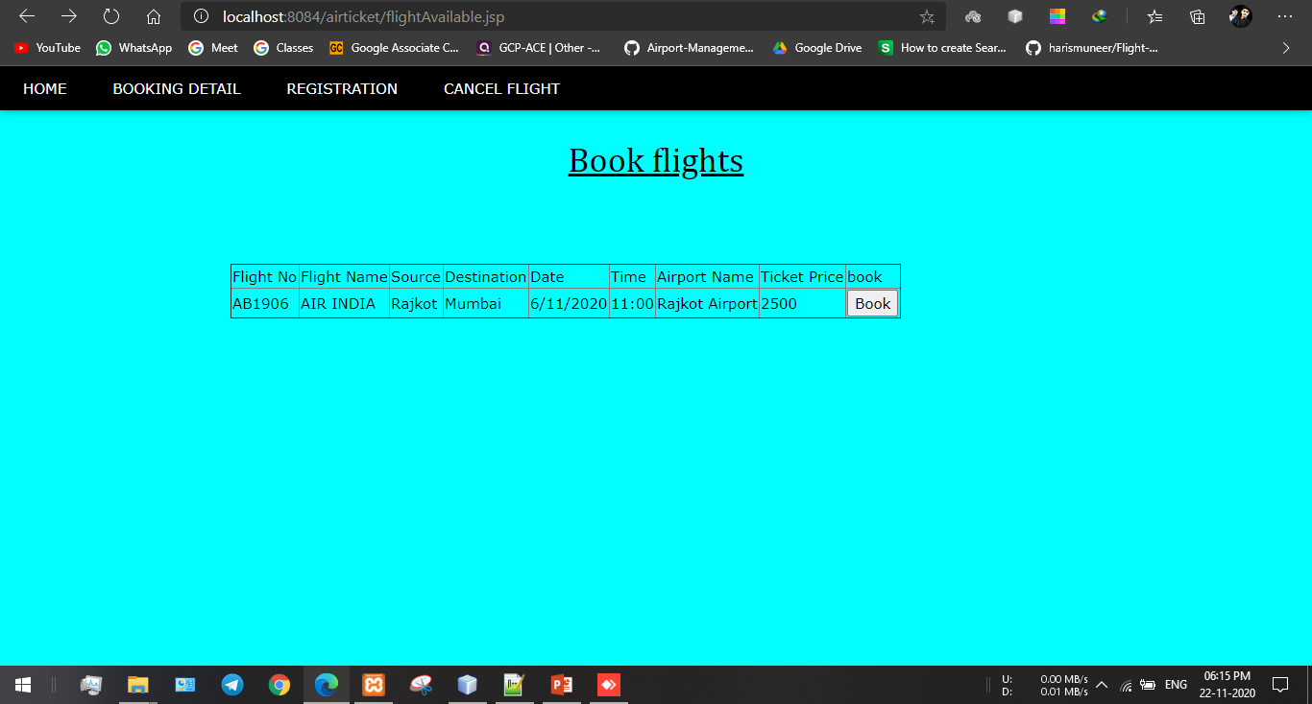
Book Flight.

Slide 18
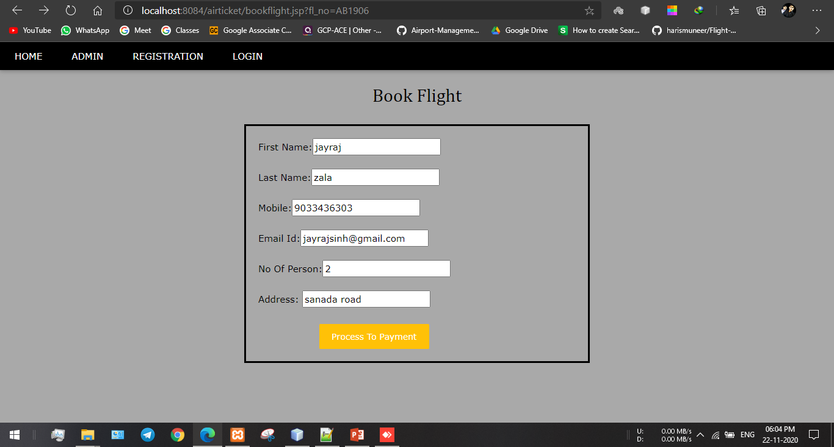
Book Flight.

Slide 19
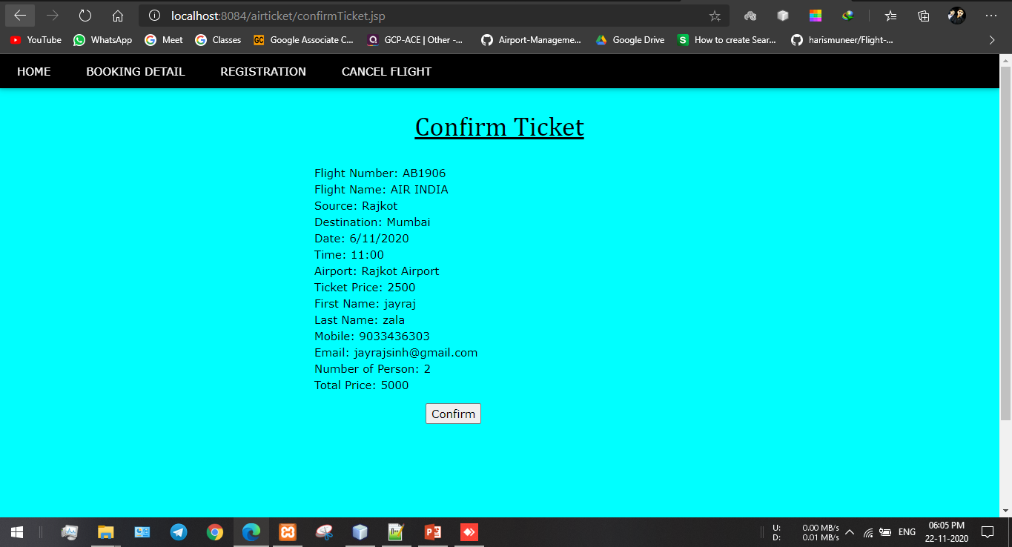
Confirm Ticket.

Slide 20
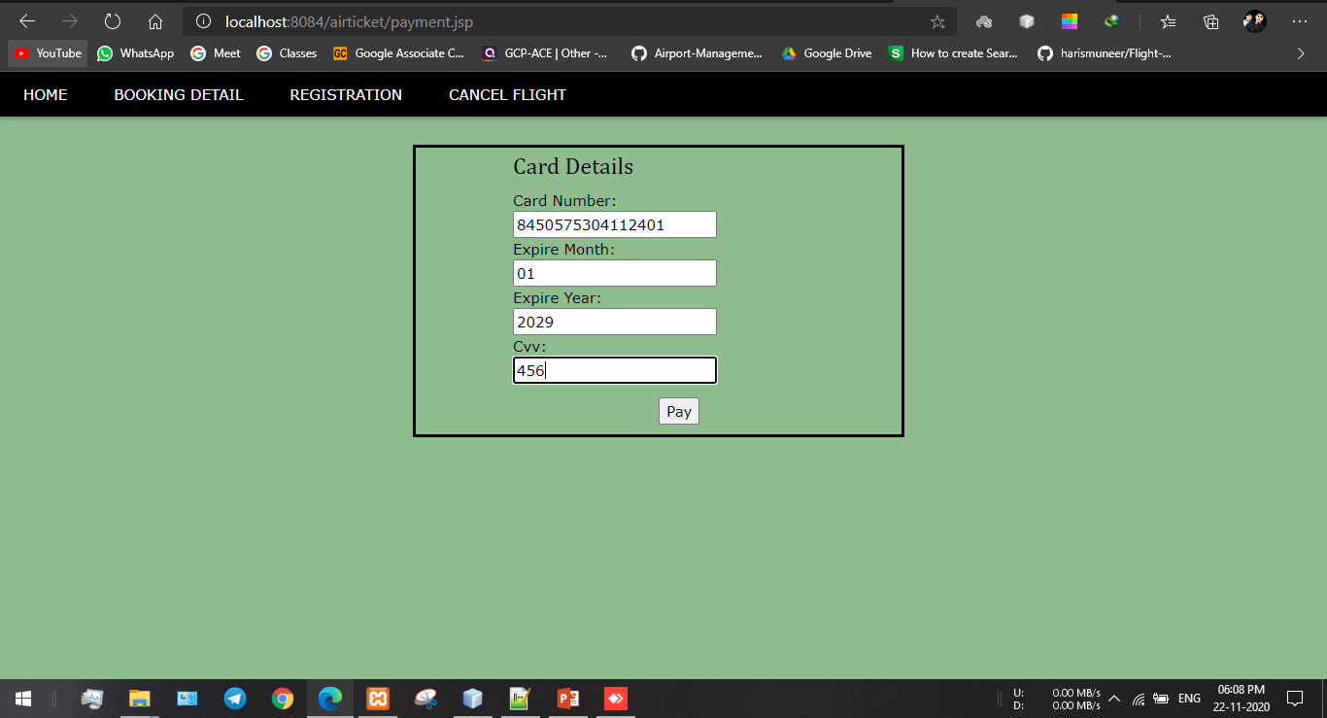
Payment.

Slide 21
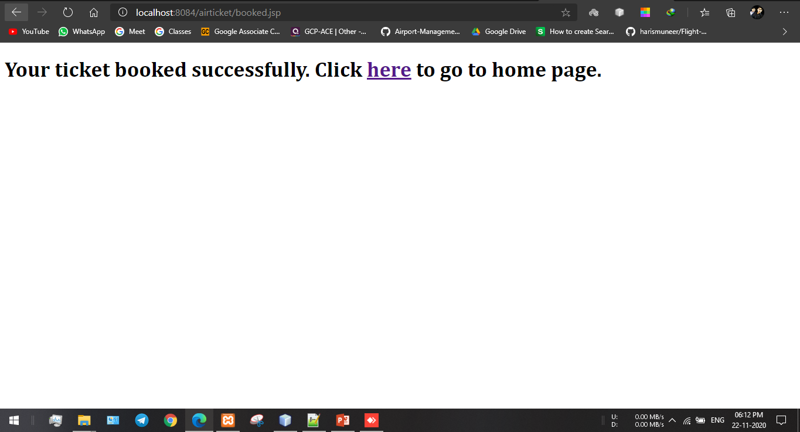
Successfully Booked.

Slide 22
Database Setup.
Database name : airline
Total of table : 4
1. admin.
2. booked.
3. flight.
4. user.

Slide 23
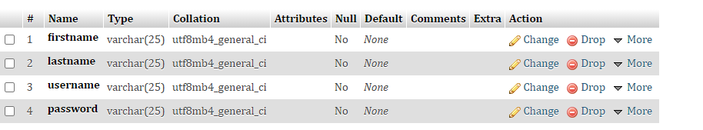
1.Admin table

Slide 24
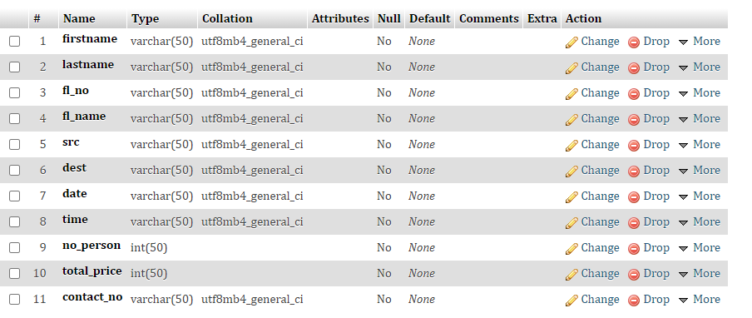
2. Booked.

Slide 25
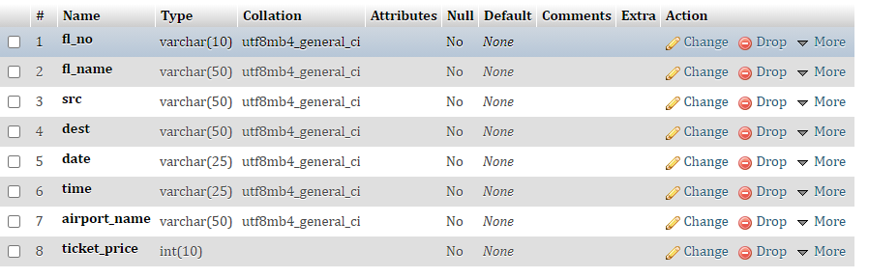
3.Flight table

Slide 26
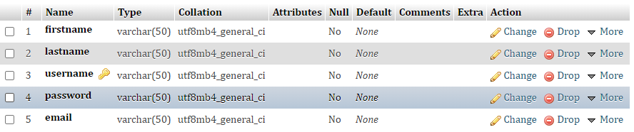
4. User.

Slide 27
THANK YOU

